Slide 1

Kiting in RTS Games Using Influence Maps
Alberto Uriarte and Santiago Ontañón
Drexel University
Philadelphia
October 9, 2012

Slide 2
Outline
Introduction
Problem Statement
StarCraft and NOVA
An Influence Map Approach to Kiting
  When Can Kiting Be Performed?
  Influence Maps for Kiting
  Target Selection
  Kiting Algorithm
Empirical Evaluation
  3 Different experiments
Conclusions and Future Work

Slide 3
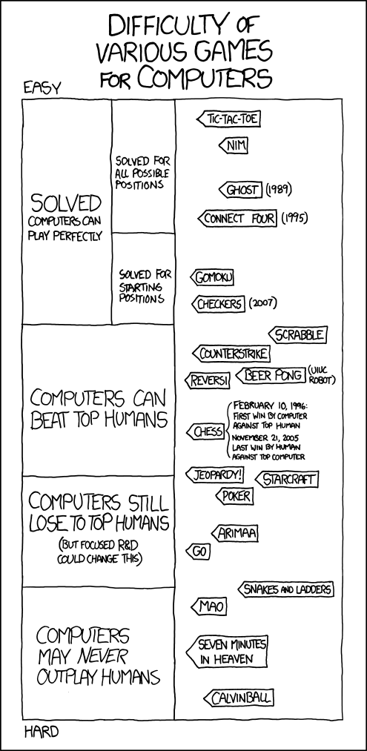
Introduction
http://www.xkcd.com/1002/

Slide 4
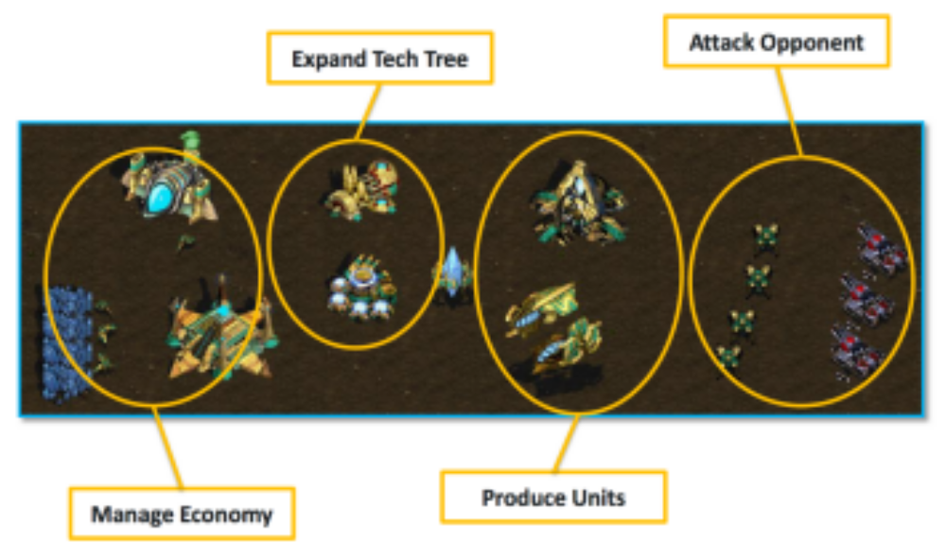
Introduction
What is a Real-Time Strategy Game?
Macro Management
Micro Management
picture from Ben Weber

Slide 5
Introduction
Challenges
Game | Stochastic | Incomplete information | Real time | Complexity (state-space)
Chess | NO | NO | NO | 10⁴⁷
Go | NO | NO | NO | 10¹⁷¹
Backgammon | YES | NO | NO
Poker | YES | YES | NO
StarCraft | YES | YES | YES | 10^{11,500}
Adversarial planning under uncertainty
Learning and opponent modeling
Spatial and temporal reasoning
All of this under real-time constrains
Notes:
Sources about Complexity

Slide 6
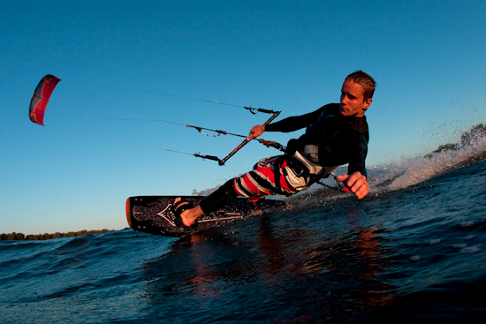
Problem Statement
What is kiting?

Slide 7

Problem Statement
What is kiting?
Attack Range
A
B

Slide 8
Problem Statement
What is kiting?
A
B
Kiting:
A exhibits a kiting behavior when it keeps a safe distance from B to reduce the damage taken from attacks of B while B keeps pursuing A.

Slide 9
Problem Statement
What is kiting?
A
B
Perfect Kiting:
When A is able to inflict damage to B without suffering any damage in return.

Slide 10
Problem Statement
What is kiting?
A
B
Sustained Kiting:
When A is not able to cause enough damage to kill unit B, but B is also unable to kill A.

Slide 11
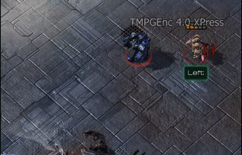
Problem Statement
What is kiting?

Slide 12
StarCraft and NOVA
Information Manager
Strategy Manager
Build Manager
Planner Manager
Squad Manager
Squad Agent
Squad Agent
Worker Manager
Production Manager
Combat Agent
Combat Agent
Squad Agent
Notes:
Add macro micro

Slide 13

An Influence Map Approach to Kiting
When Can Kiting Be Performed?
1.
A
B
Notes:
Explain what happens if both units have same speed

Slide 14
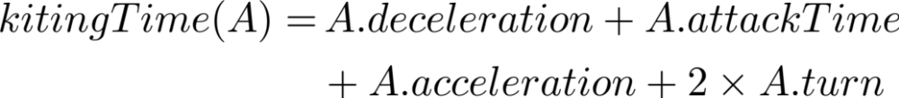

An Influence Map Approach to Kiting
When Can Kiting Be Performed?
1.
2.
attack time
A
A
A
B
turn 2
turn 1
acceleration
deceleration

Slide 15
An Influence Map Approach to Kiting
When Can Kiting Be Performed?
1.
2.
A
B

Slide 16
An Influence Map Approach to Kiting
Influence Map
Abstract information of relevant areas (numerical influence).
Spatial partition (walk tile map).

Slide 17
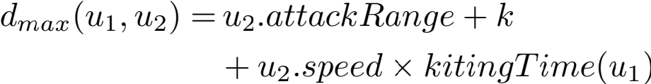
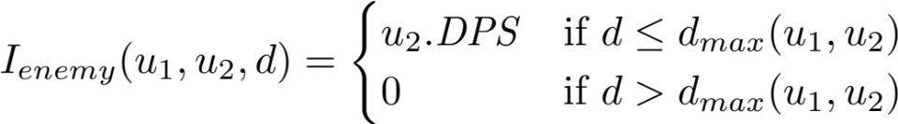
An Influence Map Approach to Kiting
Influence Map
Influence Fields
 |  |  | 3 | 3 | 3
 |  | 3 | 3 | 3 | 3 | 3
 |  | 3 | 3 |  | 3 | 3
 |  | 3 | 3 | 3 | 3 | 3
 |  |  | 3 | 3 | 3
Enemy unit

Slide 18
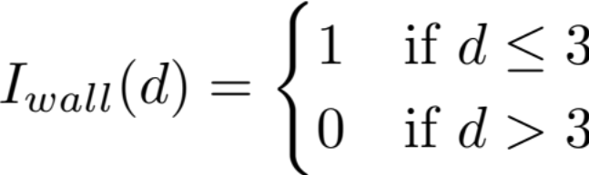
An Influence Map Approach to Kiting
Influence Map
Influence Fields
1 | 1 | 1 | 1 | 1 | 1 | 1
1 | 1 | 1 | 4 | 4 | 4 | 1
 |  | 3 | 3 | 3 | 4 | 4
 |  | 3 | 3 |  | 4 | 4
 |  | 3 | 3 | 3 | 4 | 4
 |  |  | 3 | 3 | 4 | 1
 |  |  |  |  | 1 | 1
Walls

Slide 19
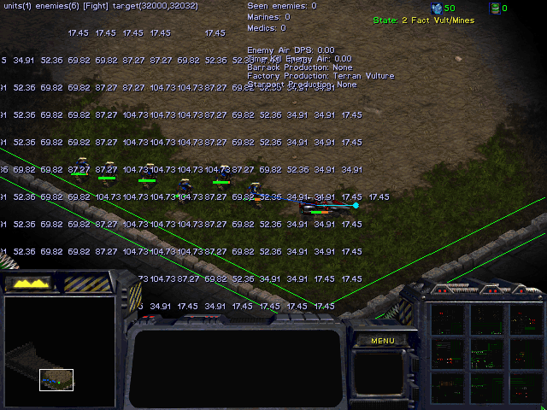
An Influence Map Approach to Kiting
Influence Map Example

Slide 20
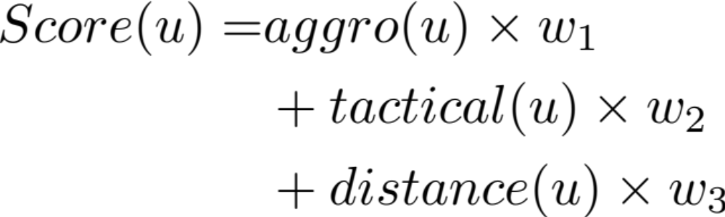
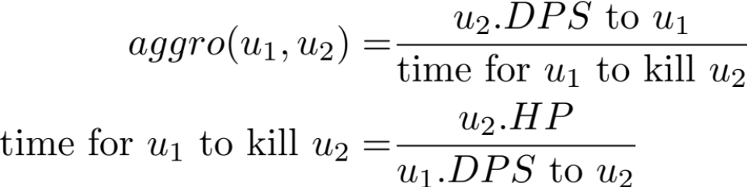
An Influence Map Approach to Kiting
Target Selection

Slide 21
An Influence Map Approach to Kiting
Kiting Algorithm
tick() {
target = targetSelection();
if (canKite(target)) {
kitingAttack(target);
} else {
attack(target);
}
}
kitingAttack(target) {
position = getSecurePosition(actualPos);
if (position == actualPos) {
attack(target);
} else {
move(position); // flee movement
}
}

Slide 22
Empirical Evaluation
Experiment 1 – 1 Vulture vs 6 Zealots
Settings:
Default behavior
Influence Map (enemy)
Influence Map (enemy + walls)
IM + Target Selection (perfect kiting)
vs
After 1.000 games with each setting
Setting | 1 | 2 | 3 | 4
Games won | 0.0 % | 24.9 % | 85.5 % | 95.2 %
Notes:
Explain huge improvement because walls
60 sec.

Slide 23
Empirical Evaluation
Experiment 2 – 4 Vultures vs 6 Zealots
Settings:
Default behavior
Influence Map (enemy)
Influence Map (enemy + walls)
IM + Target Selection (perfect kiting)
vs
After 1.000 games with each setting
Setting | 1 | 2 | 3 | 4
Games won | 0.0 % | 98.8 % | 100 % | 100 %

Slide 24
Empirical Evaluation
Comparison between experiment 1 and 2
Experiment 1
Experiment 2

Slide 25
Empirical Evaluation
Experiment 3 – 1 Full Game
Settings:
Default behavior
Influence Map (enemy)
Influence Map (enemy + walls)
IM + Target Selection (perfect kiting)
vs
After 1.000 games with each setting
Setting | 1 |  |  | 4
Games won | 17.6 % |  |  | 96.0 %
AIIDE 2011 Competition: http://www.youtube.com/watch?feature=player_detailpage&v=xXsx1ma3_ko#t=225s
Notes:
-3:10, 225

Slide 26

Conclusions and Future Work
Conclusions
Future work
Huge improvement when kiting is possible
% victories increases 445.45% !!!
Computationally tractable to be used in real-time conditions
More complex kiting behavior
  Earn time
  Ambush (cooperation)

