Slide 1

Game-Tree Search
over High-Level Game States in RTS Games
Alberto Uriarte and Santiago Ontañón
Drexel University
Philadelphia
October 6, 2014

Slide 2
Outline
Motivation
High-level Abstraction in RTS Games
Mapping Low-Level and High-Level States
High-level Game-Tree Search
Evaluation
Conclusions

Slide 3
Motivation
  RTS properties
  Simultaneous moves
  “Real-time”
  Partially observable
  Non deterministic
Game | Stochastic | Incomplete information | Real-time and simultaneous
Chess | NO | NO | NO
Go | NO | NO | NO
Backgammon | YES | NO | NO
Poker | YES | YES | NO
StarCraft | YES | YES | YES

Slide 4
Game complexity
State-Space Complexity
Number of legal game positions reachable from the initial position of the game.
Game | State-space
Tic-tac-toe | 10³
Reversi (Othello) | 10²⁸
Chess | 10⁴⁷
Go | 10¹⁷¹
StarCraft

Slide 5
Game complexity
State-Space Complexity
Number of legal game positions reachable from the initial position of the game.
Game | State-space
Tic-tac-toe | 10³
Reversi (Othello) | 10²⁸
Chess | 10⁴⁷
Go | 10¹⁷¹
StarCraft | 10¹⁶⁸⁵
StarCraft map: 128x128
Maximum number of units: 400
Considering only unit positions:
(128x128)⁴⁰⁰=16384⁴⁰⁰≈10¹⁶⁸⁵

Slide 6
Motivation
Game-Tree Complexity
Number of leaf nodes in the minimal solution depth of a full-width search tree.
Estimation
Using the branching factor (b) and the depth (d) of a game: b^{d}
Game | Branching | Depth
Chess | 35 | 80
Go | 360 | 200
StarCraft

Slide 7
Motivation
Game-Tree Complexity
Number of leaf nodes in the minimal solution depth of a full-width search tree.
Estimation
Using the branching factor (b) and the depth (d) of a game: b^{d}
Game | Branching | Depth
Chess | 35 | 80
Go | 360 | 200
StarCraft | 30⁵⁰ - 30²⁰⁰ | 36000
Units: 50 – 200
Actions per unit: 30
Branching factor: 30⁵⁰ - 30²⁰⁰
Length of a game: 25 minutes
25 min x 60 sec x 24 iteration per sec =
= 36000

Slide 8
High-level Abstraction in RTS games
Levels of decisions
Strategy. The whole army and buildings.
Tactics. Group of units.
Reactive Control. One unit.
We focused on tactical decisions!!

Slide 9
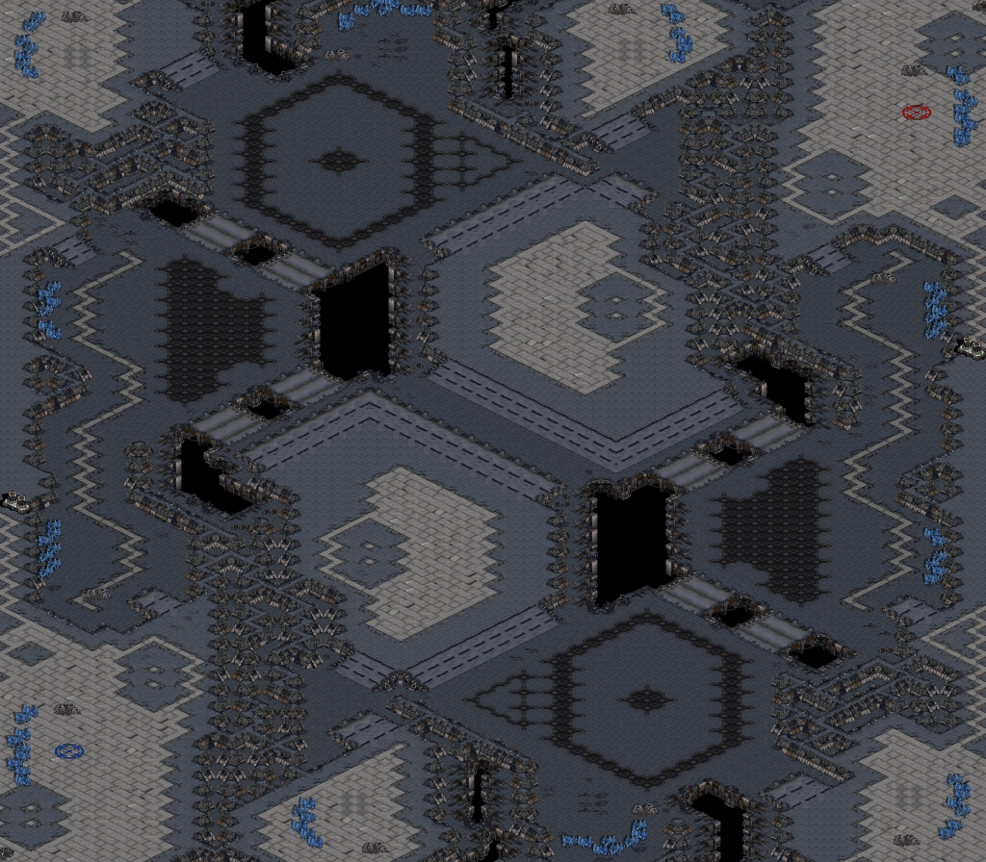
High-level Abstraction in RTS games
Two different abstractions:
1. Map abstraction

Slide 10
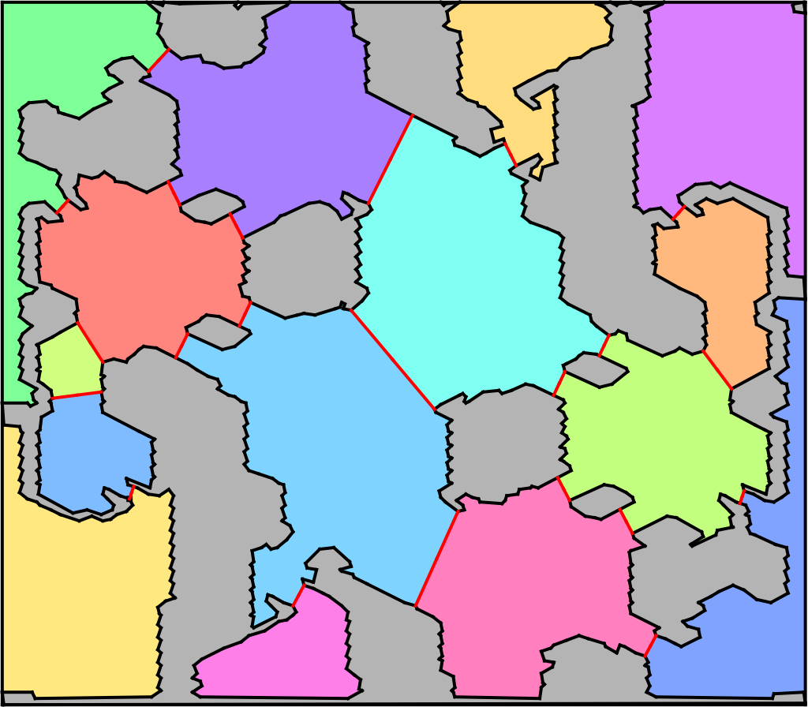
High-level Abstraction in RTS games
Two different abstractions:
1. Map abstraction
Perkins’ algorithm to decompose a map into regions and chokepoints.
Notes:
Voronoi diagram

Slide 11
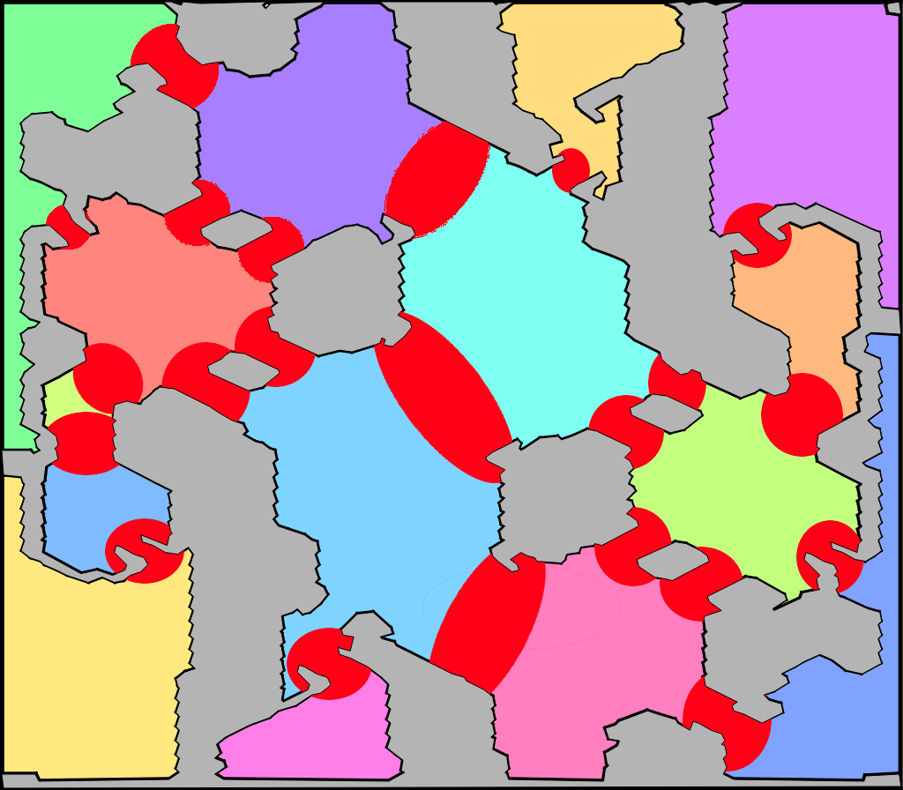
High-level Abstraction in RTS games
Two different abstractions:
1. Map abstraction
New regions around chokepoint influence

Slide 12
High-level Abstraction in RTS games
Two different abstractions:
1. Map abstraction
All distances are pre-computed

Slide 13

High-level Abstraction in RTS games
Two different abstractions:
2. Unit group abstraction
Hit Points (shield)
Position
Order:
  move, attack, stop, patrol
  repair, build, siege
Size
Damage (points and type)

Slide 14
High-level Abstraction in RTS games
Two different abstractions:
2. Unit group abstraction
Player. Which player controls this group
Type. Type of units in this group
Size. Number of units forming this group
Region. Which region is this group in
Order. Which order is currently performing
  N/A, Move, Attack, Idle
Target. The ID of the target region
End. In which game frame is the order estimated to finish

Slide 15
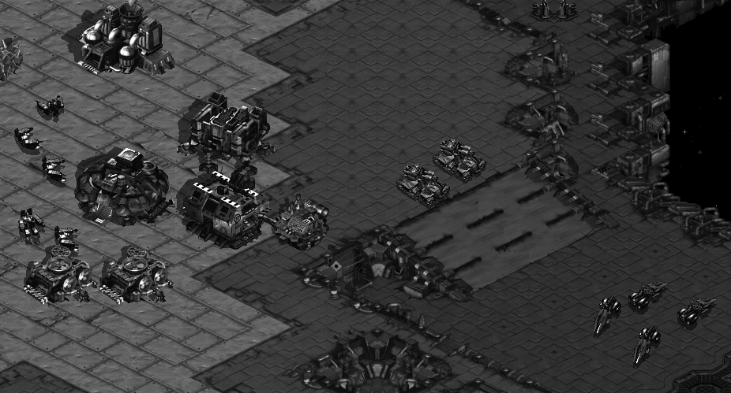
High-level Abstraction in RTS games
We only consider military units and main bases

Slide 16
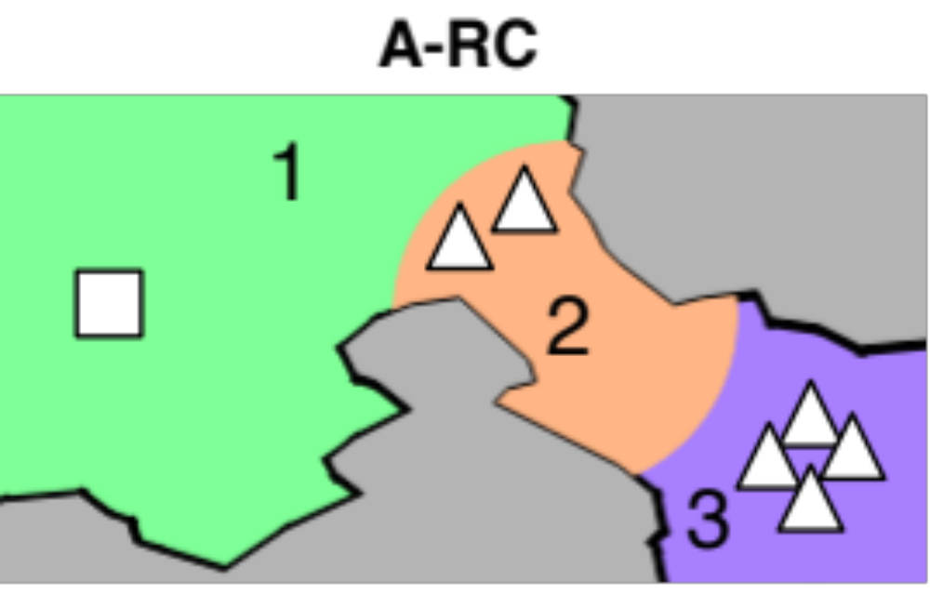
High-level Abstraction in RTS games
We only consider military units and main bases

Slide 17
High-level Abstraction in RTS games
Abstract state
Player | Type | Size | Region | Order | Target | End
1 | Base | 1 | 1 | N/A | - | -
1 | Tank | 2 | 2 | Move | 3 | 230
1 | Vulture | 4 | 3 | Idle | - | 400

Slide 18
High-level Abstraction in RTS games
Abstract state. Possible Actions
Player | Type | Size | Region | Order | Target | End
1 | Base | 1 | 1 | N/A | - | -
1 | Tank | 2 | 2 | Move | 3 | 230
1 | Vulture | 4 | 3 | Idle | - | 400

Slide 19
High-level Abstraction in RTS games
Abstract state. Possible Actions
Player | Type | Size | Region | Order | Target | End
1 | Base | 1 | 1 | N/A | - | -
1 | Tank | 2 | 2 | Move | 3 | 230
1 | Vulture | 4 | 3 | Idle | - | 400
Move to 1. Move to 3. Idle

Slide 20
High-level Abstraction in RTS games
Abstract state. Possible Actions
Player | Type | Size | Region | Order | Target | End
1 | Base | 1 | 1 | N/A | - | -
1 | Tank | 2 | 2 | Move | 3 | 230
1 | Vulture | 4 | 3 | Idle | - | 400
Move to 2, 4, 5 or 6. Idle

Slide 21
High-level Abstraction in RTS games
Abstract state. Possible Actions
Player | Type | Size | Region | Order | Target | End
1 | Base | 1 | 1 | N/A | - | -
1 | Tank | 2 | 2 | Move | 3 | 230
1 | Vulture | 4 | 3 | Idle | - | 400
Branching factor: (1)×(2+1)×(4+1) = 15

Slide 22
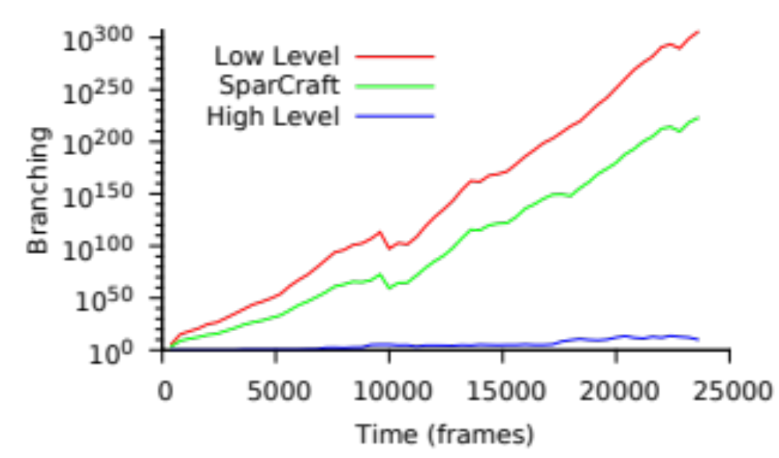
High-level Abstraction in RTS games
SparCraft (Churchill, Saffidine, and Buro 2012)
Notes:
10^10
15 minutes

Slide 23
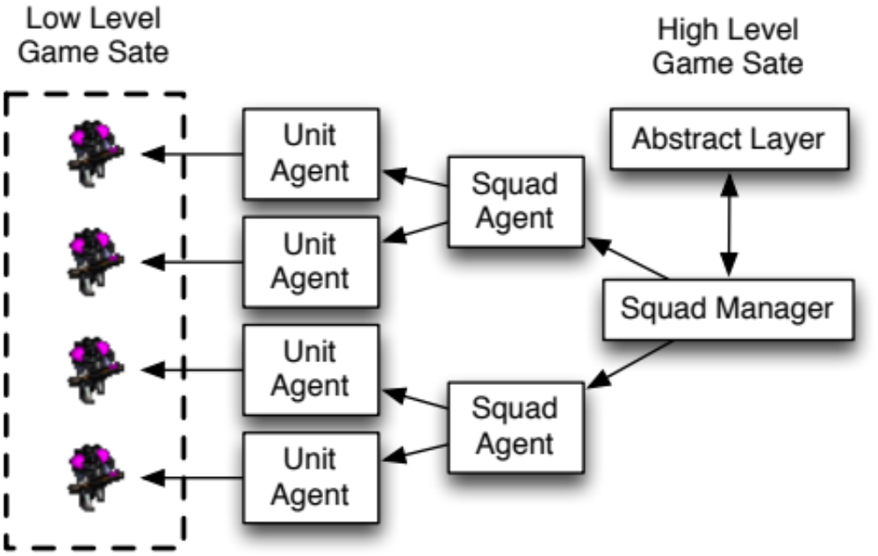
Mapping Low-Level and High-Level States
Squad groups don’t have to be the same as abstract groups!!
Notes:
10^10

Slide 24
High-level Game-Tree Search
State forwarding (simulator)
  We estimate in which game frame the group finish their order.
  Moving: velocity + distance to region
  Attack: DPS between groups
  Next player to move: the one with the group with the smallest “end” frame.

Slide 25
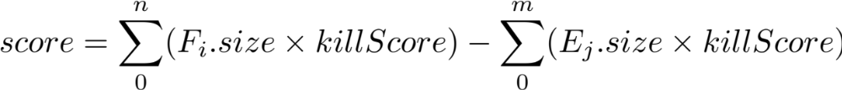
High-level Game-Tree Search
State forwarding (simulator)
  We estimate in which game frame the group finish their order.
  Moving: velocity + distance to region
  Attack: DPS between groups
State evaluation

Slide 26
High-level Game-Tree Search
Alpha-Beta
MCTS

Slide 27
High-level Game-Tree Search
Alpha-Beta
MCTS
ABCD (Churchill, Saffidine, and Buro 2012)
UCTCD
MCTSCD

Slide 28
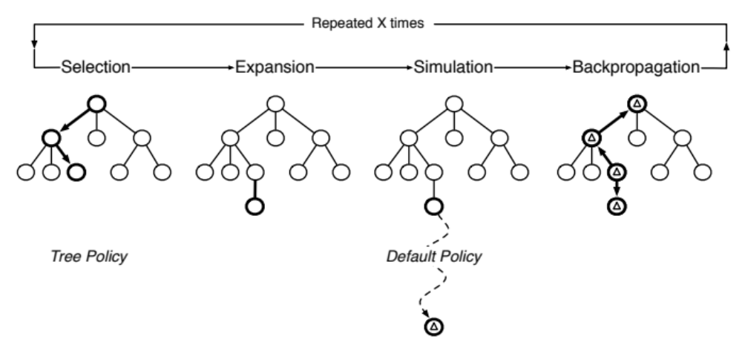
High-level Game-Tree Search
MCTSCD

Slide 29
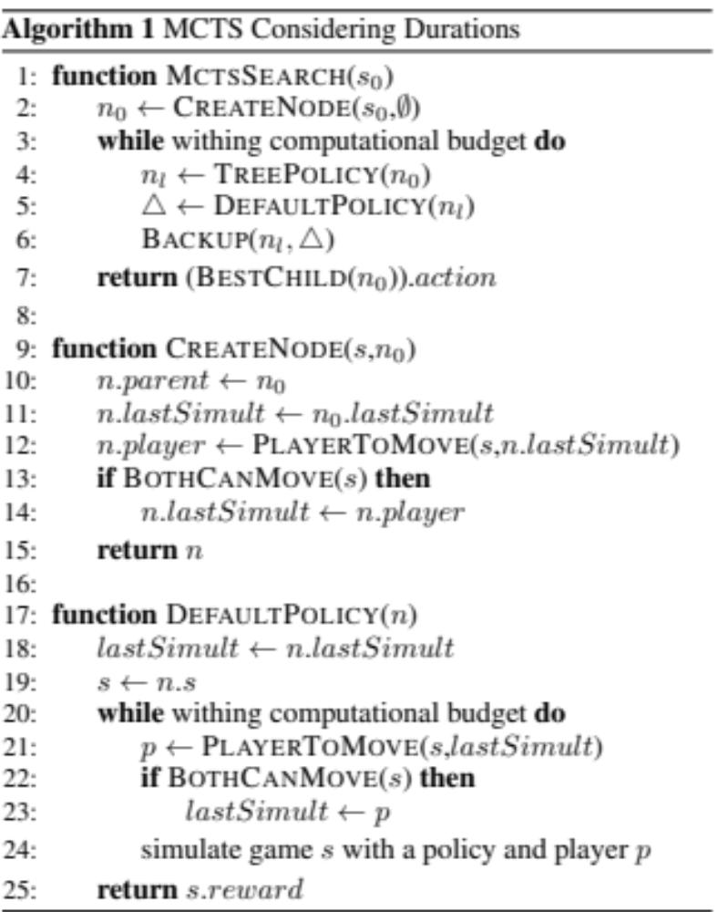
High-level Game-Tree Search

Slide 30
High-level Game-Tree Search

Slide 31
Evaluation settings
Games limited to 20 minutes (28,800 frames)
Search called every 400 frames (pause game)
No fog of war (future work)
Notes:
400 frames = 16 seconds

Slide 32
Evaluation settings
Games limited to 20 minutes (28,800 frames)
Search called every 400 frames (pause game)
No fog of war (future work)
ABCD parameters
  Maximum depth: 3
  Children limited to 10,000 nodes
  Time limited to 30 seconds
  Simultaneous move: Alt policy

Slide 33
Evaluation settings
Games limited to 20 minutes (28,800 frames)
Search called every 400 frames (pause game)
No fog of war (future work)
MCTSCD parameters
  Tree policy: e-greedy (e=0.2)
  Default policy: random move selection
  Simultaneous move: Alt policy
  Tree policy depth: limited to 10
  2,000 playouts limited to 7,200 game frames (5 minutes)

Slide 34
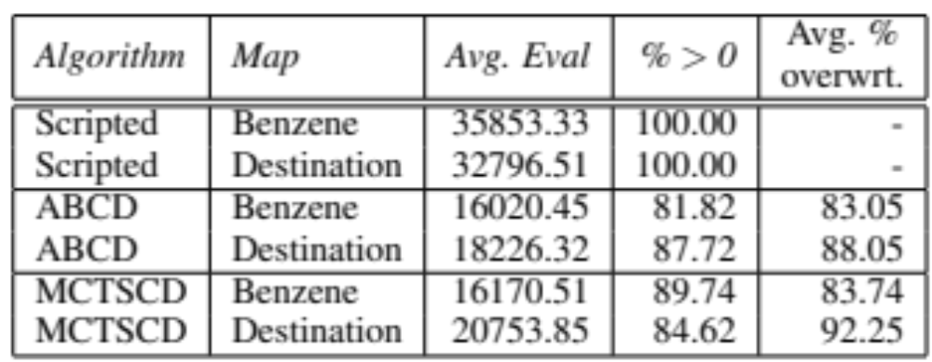
Results

Slide 35
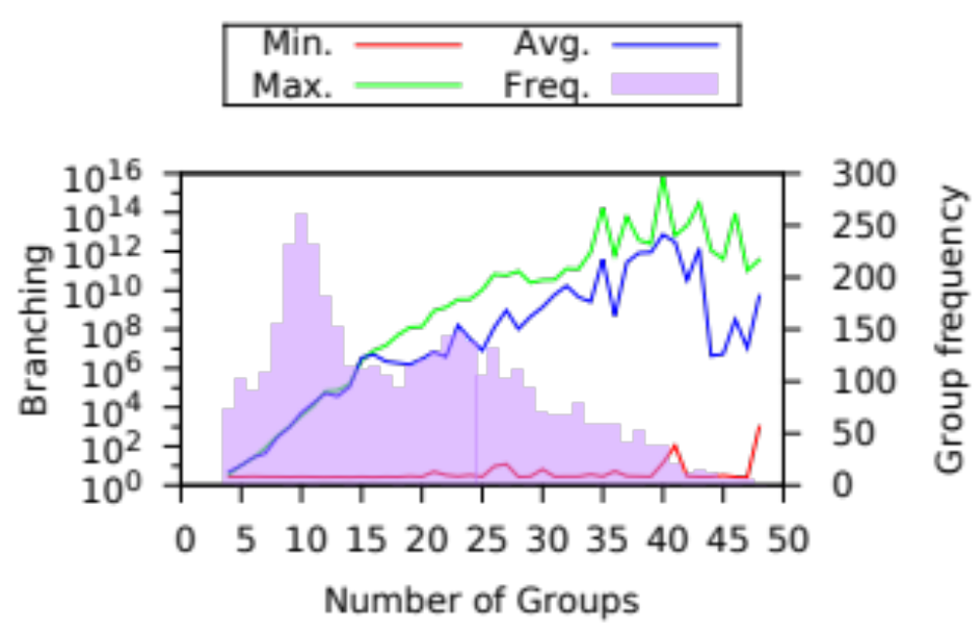
Results

Slide 36
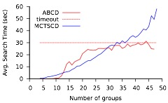
Results

Slide 37
Conclusions and Future Work
Conclusions
Future work
New MCTS algorithm for simultaneous actions (MCTSCD)
High level abstraction in the right direction to be able to apply game-tree search algorithms
Improve the game tree search algorithm
  different bandit strategies
  deal with partial observability
More abstractions and their tradeoffs
Improve the game simulator by learning during the course of a game

Slide 38

Game-Tree Search
over High-Level Game States in RTS Games
Alberto Uriarte albertouri@cs.drexel.edu
Santiago Ontañón santi@cs.drexel.edu

