Slide 1

High-level Representations
for Game-Tree Search in RTS Games
Alberto Uriarte and Santiago Ontañón
Drexel University
Philadelphia
October 3, 2014

Slide 2
Outline
Motivation
High-level Abstraction in RTS Games
High-level Game-Tree Search
Evaluation
  Bot Performance
  Simulation Accuracy
Conclusions

Slide 3
Motivation
  RTS properties
  Simultaneous moves
  “Real-time”
  Partially observable
  Non deterministic
Game | Stochastic | Incomplete information | Real-time and simultaneous
Chess | NO | NO | NO
Go | NO | NO | NO
Backgammon | YES | NO | NO
Poker | YES | YES | NO
StarCraft | YES | YES | YES

Slide 4
Game complexity
State-Space Complexity
Number of legal game positions reachable from the initial position of the game.
Game | State-space
Tic-tac-toe | 10³
Reversi (Othello) | 10²⁸
Chess | 10⁴⁷
Go | 10¹⁷¹
StarCraft | 10¹⁶⁸⁵
StarCraft map: 128x128
Maximum number of units: 400
Considering only unit positions:
(128x128)⁴⁰⁰=16384⁴⁰⁰≈10¹⁶⁸⁵

Slide 5
Motivation
Game-Tree Complexity
Number of leaf nodes in the minimal solution depth of a full-width search tree.
Estimation
Using the branching factor (b) and the depth (d) of a game: b^{d}
Game | Branching | Depth
Chess | 35 | 80
Go | 360 | 200
StarCraft | 30⁵⁰ - 30²⁰⁰ | 36000
Units: 50 – 200
Actions per unit: 30
Branching factor: 30⁵⁰ - 30²⁰⁰
Length of a game: 25 minutes
25 min x 60 sec x 24 iteration per sec =
= 36000

Slide 6
High-level Abstraction in RTS games
Levels of decisions
Strategy. The whole army and buildings.
Tactics. Group of units.
Reactive Control. One unit.
We focused on tactical decisions!!

Slide 7
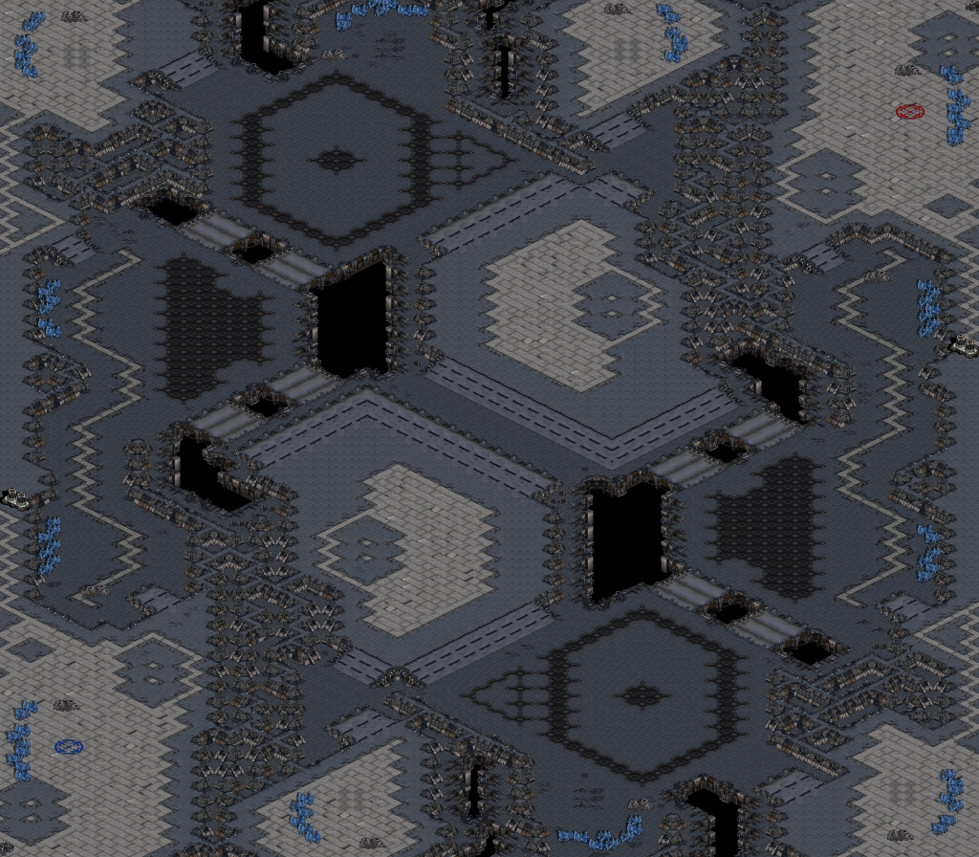
High-level Abstraction in RTS games
Two different abstractions:
1. Map abstraction

Slide 8
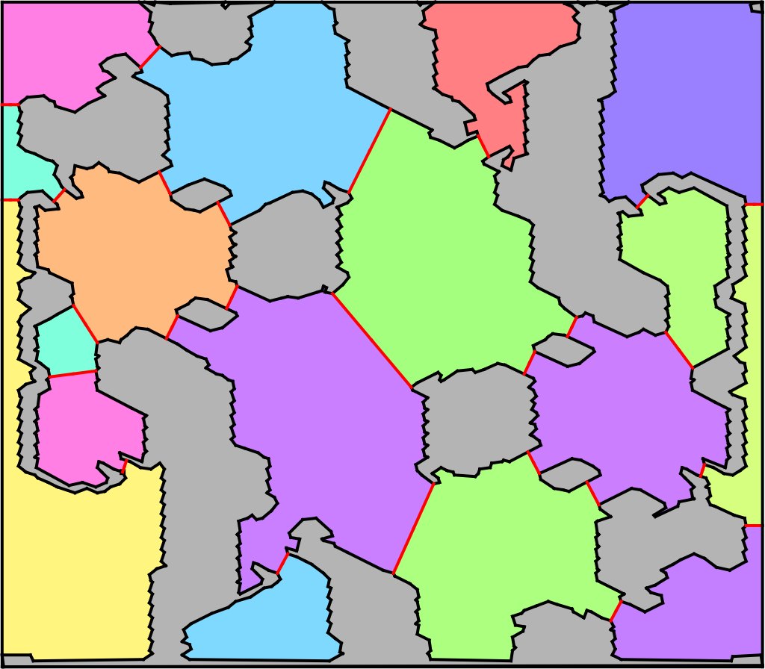
High-level Abstraction in RTS games
Two different abstractions:
1. Map abstraction
Perkins’ algorithm to decompose a map into regions and chokepoints.

Slide 9
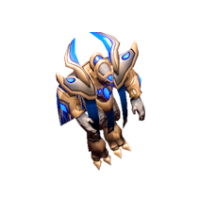
High-level Abstraction in RTS games
Two different abstractions:
2. Unit group abstraction
Hit Points (shield)
Position
Order:
  move, attack, stop, patrol
  repair, build, siege
Size
Damage (points and type)

Slide 10
High-level Abstraction in RTS games
Two different abstractions:
2. Unit group abstraction
Player. Which player controls this group
Type. Type of units in this group
Size. Number of units forming this group
Region. Which region is this group in
Order. Which order is currently performing
  Move, Attack, Idle
Target. The ID of the target region
End. In which game frame is the order estimated to finish

Slide 11
High-level Abstraction in RTS games
Two different abstractions:
2. Unit group abstraction
Group | Player | Type | Size | Region | Order | Target | End
1 | 1 | 3 | 5 | 4 | Move | 5 | 670
2 | 1 | 3 | 2 | 3 | Move | 4 | 100
3 | 1 | 2 | 8 | 4 | Idle | - | 400
4 | 2 | 3 | 8 | 15 | Move | 13 | 350

Slide 12
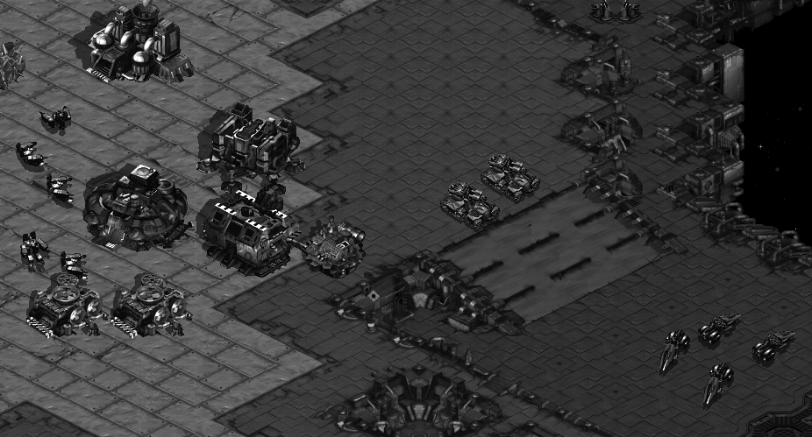
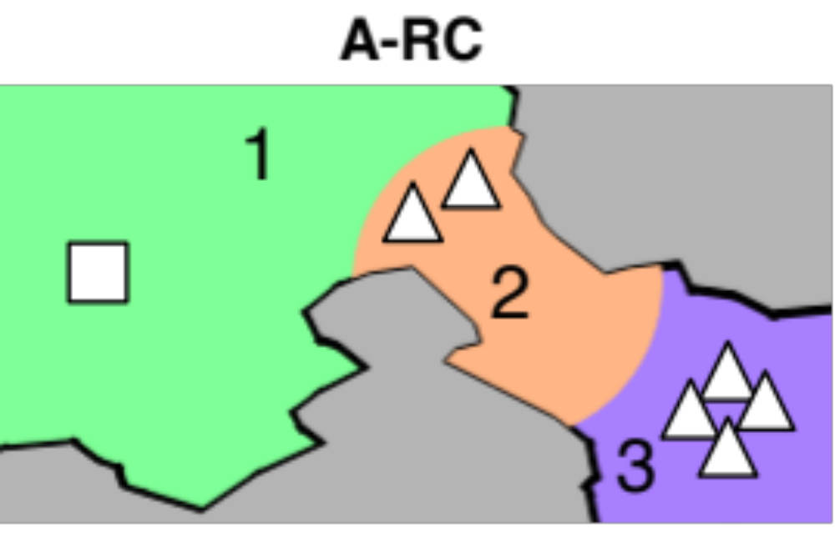
High-level Abstraction in RTS games
Experiments with 4 different abstractions:
1. A-RC Regions, Chokepoints, NO Buildings

Slide 13
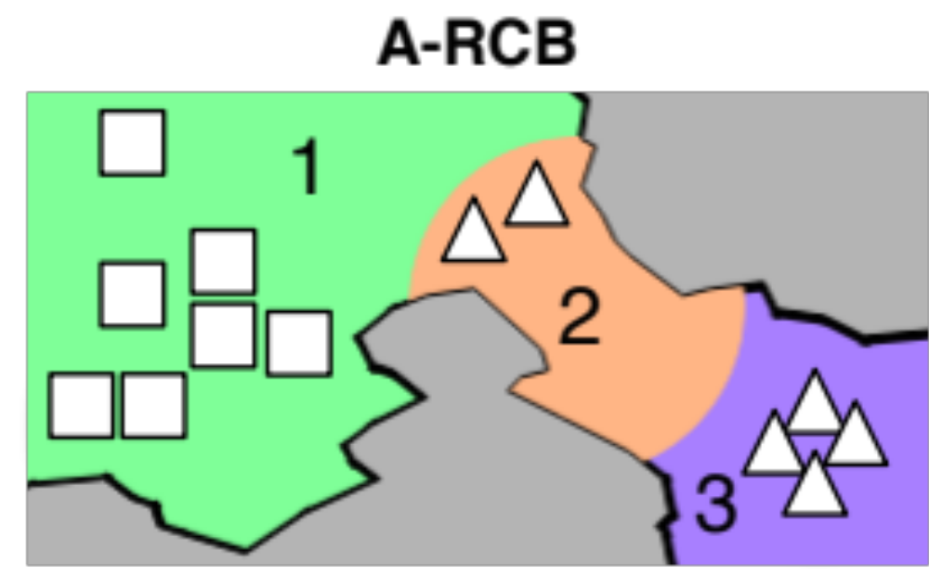
High-level Abstraction in RTS games
Experiments with 4 different abstractions:
2. A-RCB Regions, Chokepoints, Buildings

Slide 14
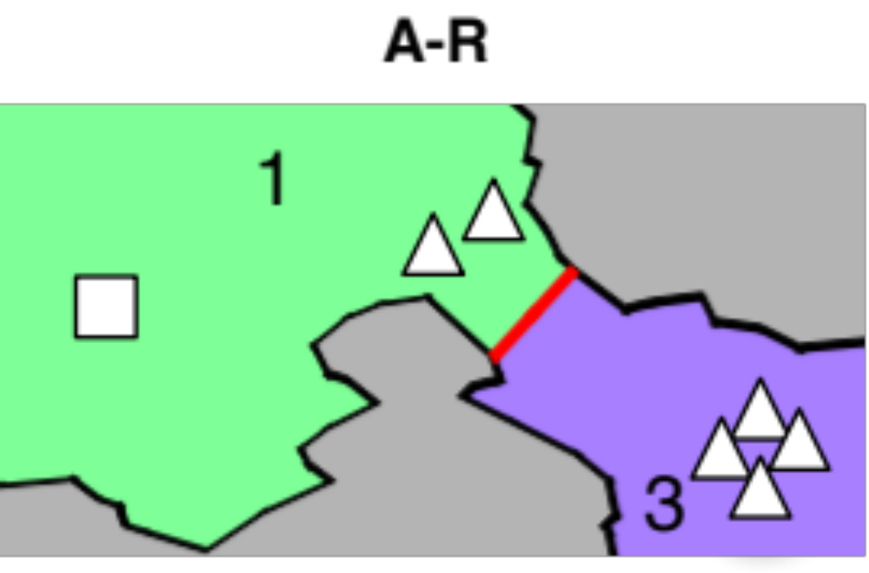
High-level Abstraction in RTS games
Experiments with 4 different abstractions:
3. A-R Regions, NO Chokepoints, NO Buildings

Slide 15
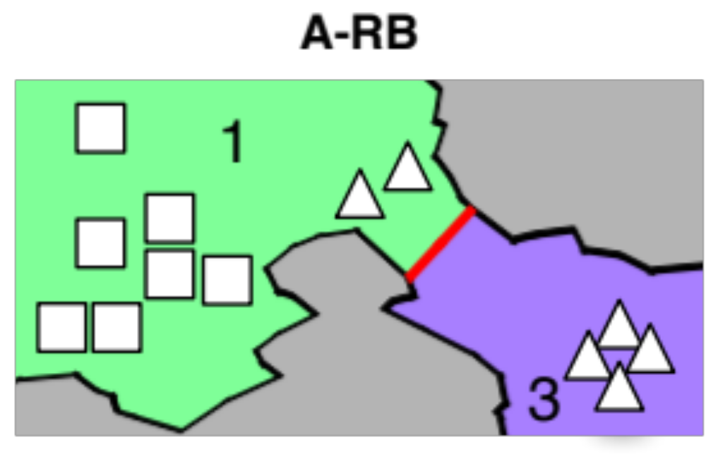
High-level Abstraction in RTS games
Experiments with 4 different abstractions:
4. A-RB Regions, NO Chokepoints, Buildings

Slide 16
High-level Game-Tree Search
Alpha-Beta
MCTS

Slide 17
High-level Game-Tree Search
Alpha-Beta
MCTS
ABCD
UCTCD
MCTSCD

Slide 18
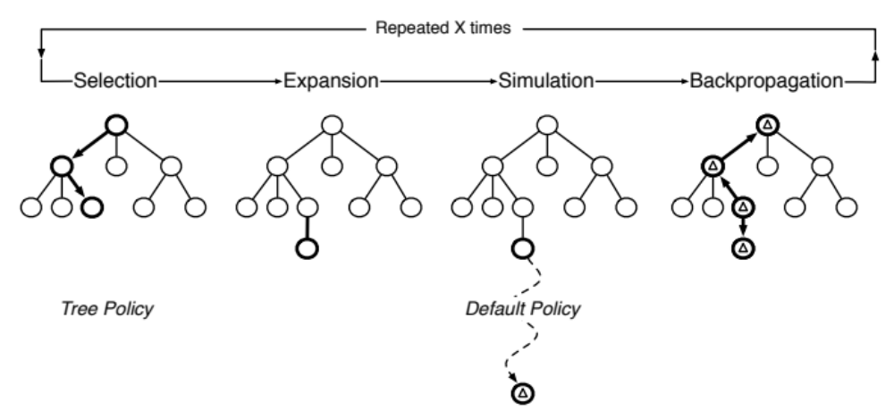
High-level Game-Tree Search
MCTSCD

Slide 19
High-level Game-Tree Search
MCTSCD
State forwarding (simulator)
  We estimate in which game frame the group finish their order.
  Moving: velocity + distance to region
  Attack: DPS between groups

Slide 20
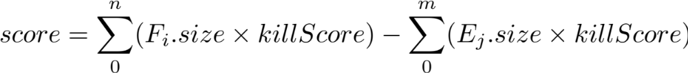
High-level Game-Tree Search
MCTSCD
State forwarding (simulator)
  We estimate in which game frame the group finish their order.
  Moving: velocity + distance to region
  Attack: DPS between groups
State evaluation

Slide 21
Evaluation settings
Games limited to 20 minutes (28,800 frames)
MCTSCD called every 400 frames
MCTSCD parameters
Tree policy: e-greedy (e=0.2)
Default policy: random move selection
Simultaneous move: Alt policy
Tree policy depth: limited to 10
1,000 playouts limited to 2,880 game frames
No fog of war (future work)

Slide 22
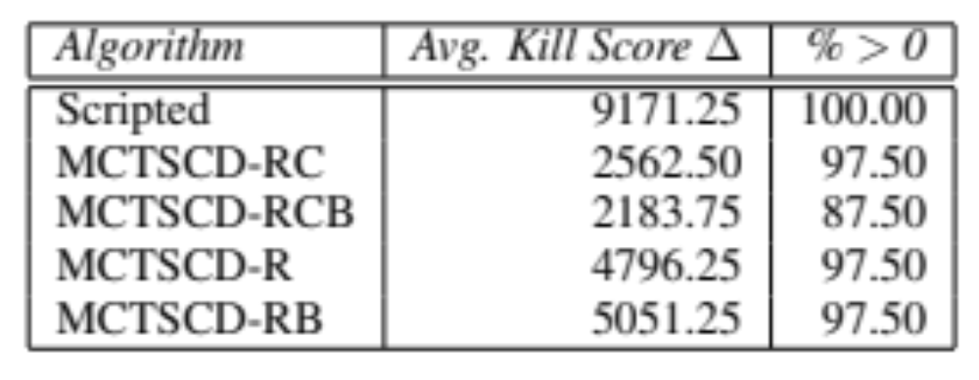
Bot Performance
MCTSCD with different abstractions

Slide 23
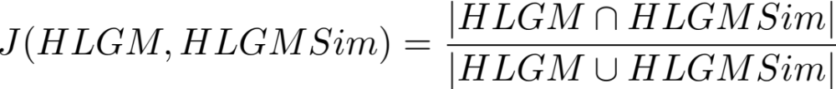
Simulation accuracy
Jaccard index computed each 400 frames

Slide 24
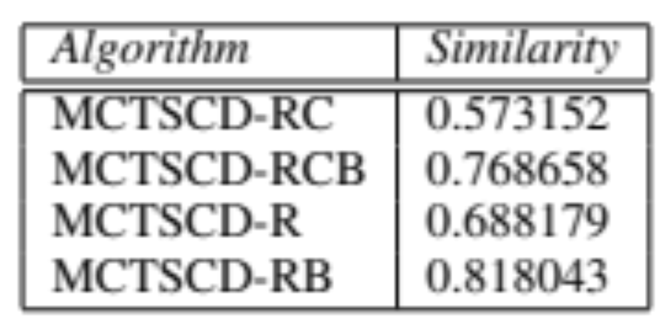
Simulation accuracy
Jaccard index computed each 400 frames

Slide 25
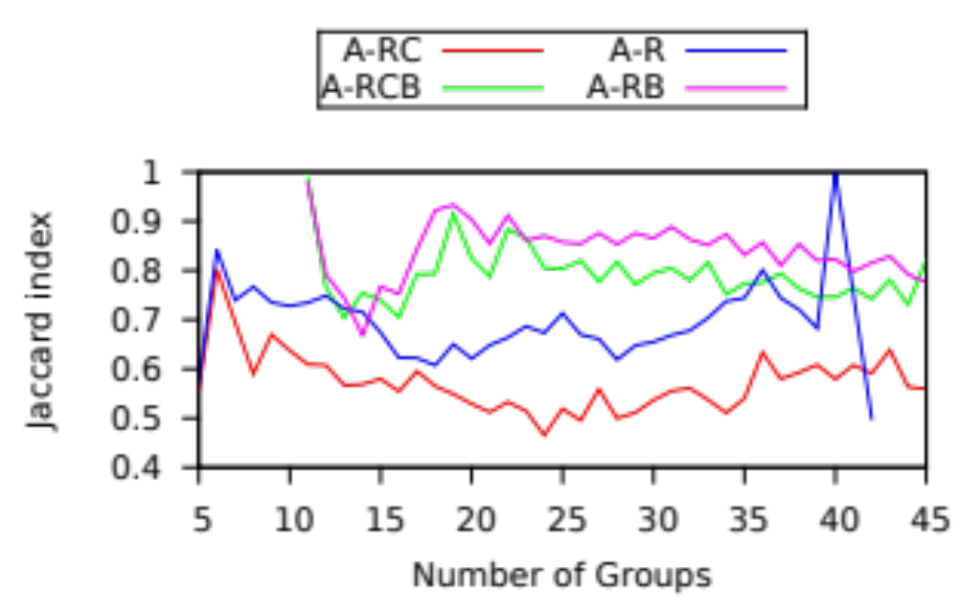
Simulation accuracy
Jaccard index computed each 400 frames

Slide 26
Conclusions and Future Work
Conclusions
Future work
Robust methodology to evaluate the accuracy of a simulator
it is better to keep the abstraction simple in order to get better predictions (no chokepoints)
Improve the game tree search algorithm
  different bandit strategies
  deal with partial observability
More abstractions and their tradeoffs
Improve the game simulator by learning during the course of a game

Slide 27

High-level Representations
for Game-Tree Search in RTS Games
Alberto Uriarte albertouri@cs.drexel.edu
Santiago Ontañón santi@cs.drexel.edu

