Slide 1

A Benchmark for StarCraft
Intelligent Agents
Alberto Uriarte and Santiago Ontañón
Drexel University
Philadelphia
November 15, 2015

Slide 2
Outline
Motivation
Metrics
Benchmark Scenarios
  Reactive Control
  Tactics
  Strategy
Experiments & Conclusions
Future Work

Slide 3
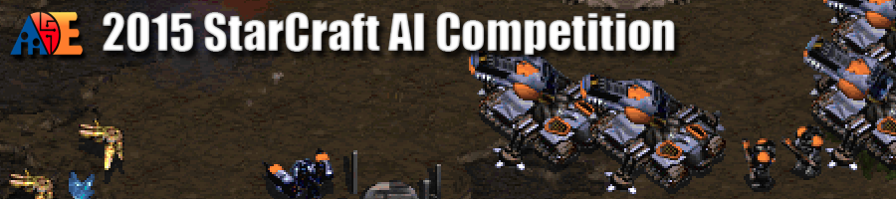
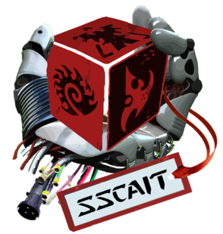
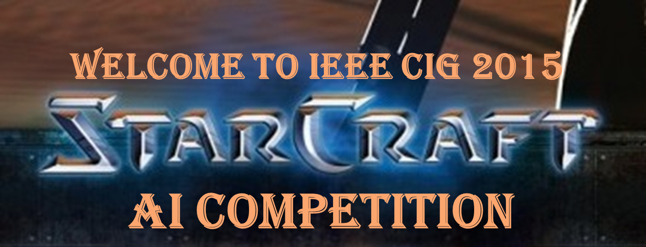
Motivation
Lots of tournaments.
Perfect to engage new researchers and overall bot performance.
How to evaluate a specific AI technique?

Slide 4

Motivation
Each researcher uses their own maps, scripts and metrics to evaluate an algorithm.
Q-Learning
https://youtu.be/0BS8Mbqbnmk
Genetic Algorithm
https://youtu.be/CYBWw-135rg
Hard to compare results!!

Slide 5

Motivation
The lack of a uniform benchmark suite was a topic in the last AIIDE (2014) AI in Adversarial Real-Time Games Workshop.

Slide 6
Goal
Uniform benchmark suite
Set of StarCraft¹ scenarios that capture different aspects of RTS game play.
Standard way to compare
Set of metrics to evaluate the performance. Set of scenarios simulating RTS specific problems.
¹StarCraft has emerged as the main test-bed for RTS research

Slide 7
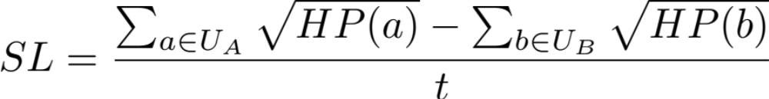
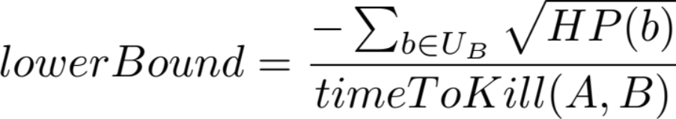
Metrics
Metrics designed to be normalized: [0,1] or [-1,1]
Survivor’s life
The sum of the square root of hit points remaining of each unit divided by amount of time it took to complete the scenario. Normalized by bounds. Lower bound is when player A is defeated in the minimum time and without dealing any damage to player B
Notes:
higher values representing better agent performance

Slide 8


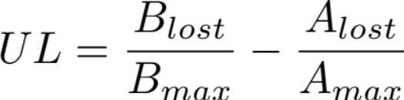
Metrics
Time survived
The time the agent survived normalized by a predefined timeout.
Time needed
Start a timer when a certain event happens (building destroyed). Stop it after a timeout or after a condition is triggered.
Units lost
Difference in units lost.
Notes:
Time survived (impossible to win, like scouting)
Refinery steal recovery
valuate how a bot can respond to a strategic attack

Slide 9
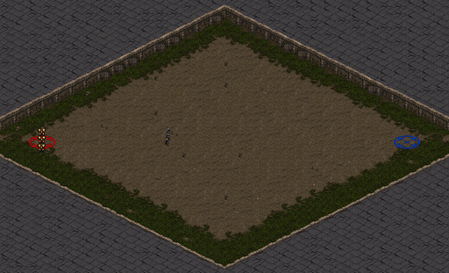
Benchmarks Scenarios
Problems:
  Reactive control (short-term decision making)
  Tactics (medium-term)
  Strategy (long-term)
Scenario constraints:
  Regular Game (start with a base and workers)
  Melee Game (only military units)

Slide 10
Benchmarks Scenarios – Reactive Control
Short-term decision-making
Custom handcrafted scenarios
Unit formation (Young et al. 2012; Danielsiek et al. 2008)
Unit survivability (Uriarte and Ontañón 2012; Nguyen, Wang, and Thawonmas 2013)
Target selection (Churchill and Buro 2013)
Maps from professional players (Young and Hawes 2014)

Slide 11
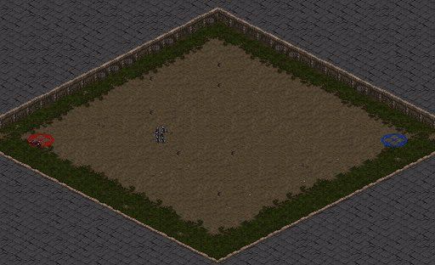
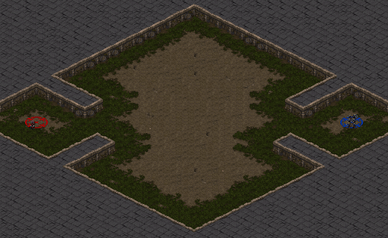
Benchmarks Scenarios – Reactive Control
RC1: Perfect Kiting
Test if is able to exploit the mobility and range attack against a stronger but slower unit. It is possible to win without taking any damage.
Metric: Survivor’s life
Map layer: A (big area), B (3 connected regions)
Configurations: VZ, V6Z, 3V6Z, V9Zg

Slide 12
Benchmarks Scenarios – Reactive Control
RC2: Kiting
Test if is able to exploit the mobility and range attack against a stronger but slower unit. It is NOT possible to win without taking any damage.
Metric: Survivor’s life
Map layer: A (big area)
Configurations: 3D3Z, 2D3H
Notes:
Hydralisk

Slide 13
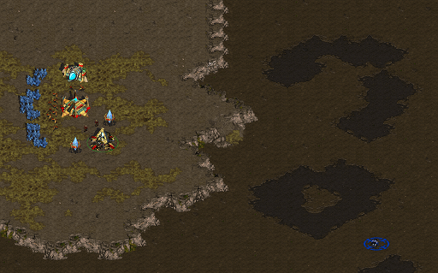
Benchmarks Scenarios – Reactive Control
RC3: Sustained Kiting
NO chance to win. Stay alive as much time as possible
Metric: Time survived
Map layer: C (two regions, one with resources)

Slide 14
Benchmarks Scenarios – Reactive Control
RC4: Symmetric armies
In equal conditions positioning and target selection are key aspects that can determine a player’s success in a battle.
Metric: Survivor’s life
Map layer: A (big area)
Configurations: 5 Vultures (Terran range) 9 Zealots (Protos melee) 12 Dragons (Protos range) 12 Mutalisks (Zerg air range with splash damage) 20 Marines and 8 Medics (Terran range) 5 Zealots and 8 Dragoons (Protos melee + range)

Slide 15
Benchmarks Scenarios – Tactics
Medium-term decision-making
Solve qualitative navigation problems (Hagelbäck 2012)
Terrain analysis to exploit chokepoints or reasoning about the immediate enemy thread (Muñoz- Avila, Dannenhauer, and Cox 2015)
Optimizing resource gathering (Christensen et al. 2012; de Oliveira, Goldbarg, and Goldbarg 2014)
Building placement (Certicky 2013; Richoux, Uriarte, and Ontañón 2014)

Slide 16
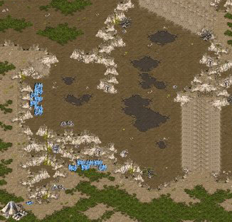
Benchmarks Scenarios – Tactics
T1: Dynamic obstacles
Measures how well an agent can navigate when chokepoints are blocked by dynamic obstacles (e.g., neutral buildings).
Metric: Time needed to reach a starting position
Map layer: Heartbreak Ridge
START
CHOKE POINT
GOAL
BLOCKED PATH
https://youtu.be/nt2ZSDue9kM

Slide 17
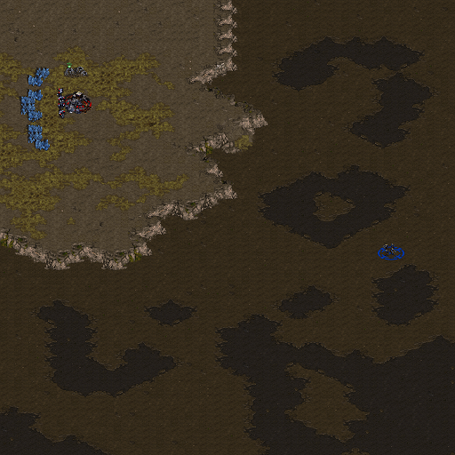
Benchmarks Scenarios – Strategy
S1: Building placement
This scenario simulates a Zealot rush and is designed to test whether the agent will be able to stop it (intuitively, it seems the only option is to build a wall).
Metric: Units lost
Map layer: C (two regions, one with resources)

Slide 18
Benchmarks Scenarios – Strategy
S2: Plan recovery
Test if the AI is able to recover from the opponent disrupting its build order (destroy refinery after built)
Metric: Time spent
Map layer: C (two regions, one with resources)
All Benchmark scenarios are available on-line
https://bitbucket.org/auriarte/starcraftbenchmarkai
http://www.starcraftai.com/wiki/StarCraft_AI_Benchmarks

Slide 19
Experiments & Conclusions
All scenarios were tested with bots that participated in previous AIIDE tournaments. (Not all bots can play melee maps!!)
 | RC1 | RC2 | RC3 | RC4 | T1 | S1 | S2
FreScBot | -0.0879 | -0.1153 | N/A | -0.0022 | N/A | N/A | N/A
Nova | 0.1111 | N/A | 0.0335 | N/A | 0.0000 | -0.7420 | 0.0000
Skynet | -0.1087 | 0.1696 | N/A | 0.0706 | N/A | N/A | N/A
UAlbertaBot | -0.0933 | 0.0422 | N/A | 0.0369 | N/A | -1.0000 | 0.0000

Slide 20
Experiments & Conclusions
All scenarios were tested with bots that participated in previous AIIDE tournaments. (Not all bots can play melee maps!!)
 | RC1 | RC2 | RC3 | RC4 | T1 | S1 | S2
FreScBot | -0.0879 | -0.1153 | N/A | -0.0022 | N/A | N/A | N/A
Nova | 0.1111 | N/A | 0.0335 | N/A | 0.0000 | -0.7420 | 0.0000
Skynet | -0.1087 | 0.1696 | N/A | 0.0706 | N/A | N/A | N/A
UAlbertaBot | -0.0933 | 0.0422 | N/A | 0.0369 | N/A | -1.0000 | 0.0000
Newer bots improved micromanagement (FreScBot was the winner of micro AIIDE tournament 2010).
Nova perform well in kiting scenarios (as expected).
None of the bots passed the Tactics or Strategy scenarios.

Slide 21
Experiments & Conclusions
All scenarios were tested with bots that participated in previous AIIDE tournaments. (Not all bots can play melee maps!!)
 | RC1 | RC2 | RC3 | RC4 | T1 | S1 | S2
FreScBot | -0.0879 | -0.1153 | N/A | -0.0022 | N/A | N/A | N/A
Nova | 0.1111 | N/A | 0.0335 | N/A | 0.0000 | -0.7420 | 0.0000
Skynet | -0.1087 | 0.1696 | N/A | 0.0706 | N/A | N/A | N/A
UAlbertaBot | -0.0933 | 0.0422 | N/A | 0.0369 | N/A | -1.0000 | 0.0000
Newer bots improved micromanagement (FreScBot was the winner of micro AIIDE tournament 2010).
Nova perform well in kiting scenarios (as expected).
None of the bots passed the Tactics or Strategy scenarios.
Other researchers are already using the benchmark!!
“Q-learnings in RTS game's micro-management” Angel Camilo Palacios Garzón 2015

Slide 22
Future work
Scenario | Description | Metric
RC1: Perfect Kiting | Range unit can win without damage | Survivor’s life
RC2: Kiting | Range unit can win with some damage | Survivor’s life
RC3: Sustained Kiting | Unit cannot win | Time survived
RC4: Symmetric armies | Target selection and squad formation | Survivor’s life
T1: Dynamic obstacles | Pathfinding | Time needed
S1: Building Placement | Terrain analysis | Units lost
S2: Plan Recovery | Build order disrupted | Time Spent
More scenarios: Gas stealing, more scripted AIs rather than default script, use transports to avoid well protected choke points, optimizing mining, …
More metrics: bot blocked by supplies, money unspent, …
Deterministic VS Stochastic

Slide 23

A Benchmark for StarCraft
Intelligent Agents
Alberto Uriarte albertouri@cs.drexel.edu
Santiago Ontañón santi@cs.drexel.edu

