Slide 1


Improving Monte Carlo Tree Search Policies in StarCraft
via Probabilistic Models Learned from Replay Data
Alberto Uriarte and Santiago Ontañón
Drexel University
Philadelphia
October 10, 2016

Slide 2
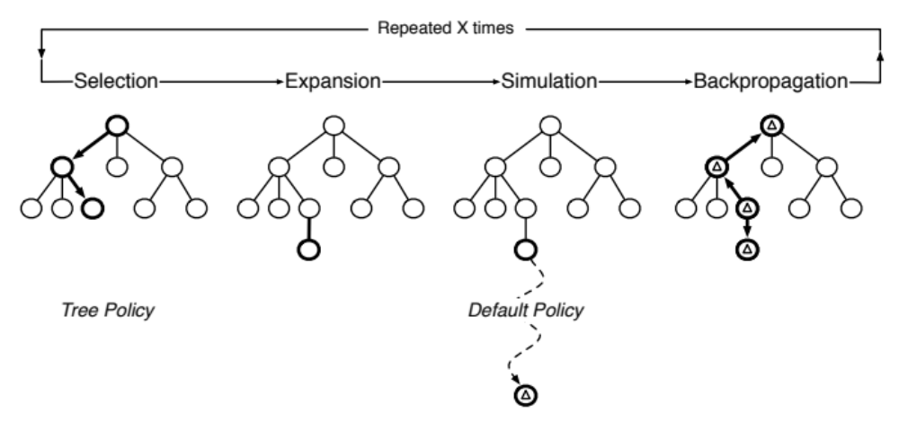
Motivation
Sorry, this paper is not really about
Monte Carlo Tree Search

Slide 3

Motivation
Sorry, this paper is not really about
Monte Carlo Tree Search
It is about the Multi-Armed Bandit Problem

Slide 4


Multi-Armed Bandit Problem

Slide 5


Multi-Armed Bandit Problem
How to pick between Slot Machines so that you walk out with most $$$ from Las Vegas?

Slide 6
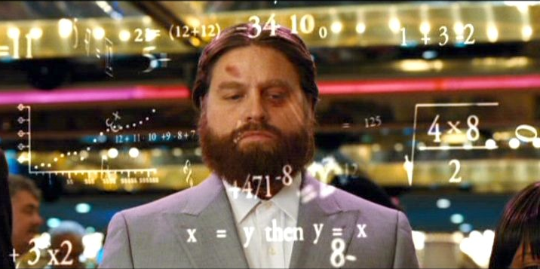
Multi-Armed Bandit Problem

Slide 7
Multi-Armed Bandit Problem
Epsilon Greedy
Upper Confidence Bounds (UCB)
Thompson sampling
…

Slide 8
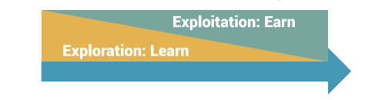
Multi-Armed Bandit Problem

Slide 9

Problem
We are broke

Slide 10
Problem
We are broke
Thousands of Slot Machines

Slide 11
Problem
We are broke
Thousands of Slot Machines
We don’t have enough budget
to explore each Slot
Machine even once!!

Slide 12
Solution: Abstraction

Slide 13
Solution: Abstraction

Slide 14


Solution: Data Acquisition

Slide 15

RTS Same Problem
Money = Computational Budget
Slot Machine = Next Action to Choose
…
Number of Slot Machines = Branching Factor

Slide 16
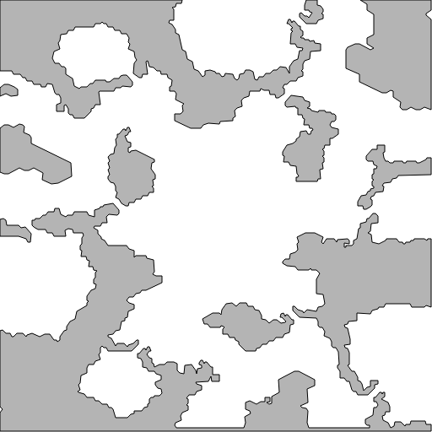
Abstraction

Slide 17
Abstraction

Slide 18
Abstraction

Slide 19
Abstraction
2
1
4
4
1
2

Slide 20
Abstraction
Idle
Attack
Move
  To Friend
  To Enemy
  Towards Friend
  Towards Enemy
2
1
4
4
1
2

Slide 21
Abstraction
Idle
Attack
Move
  To Friend
  To Enemy
  Towards Friend
  Towards Enemy
2
1
4
4
NOT To Friend, NOT To Enemy,
NOT Towards Friend, NOT Towards Enemy
1
2

Slide 22
Abstraction
Idle
Attack
Move
  To Friend
  To Enemy
  Towards Friend
  Towards Enemy
2
1
4
4
NOT To Friend, To Enemy,
NOT Towards Friend, Towards Enemy
1
2

Slide 23
Abstraction
Idle
Attack
Move
  To Friend
  To Enemy
  Towards Friend
  Towards Enemy
2
1
4
4
NOT To Friend, To Enemy,
NOT Towards Friend, Towards Enemy
1
2
Even with this abstraction the branching factor
can be too big to handle (10²⁰⁰)

Slide 24
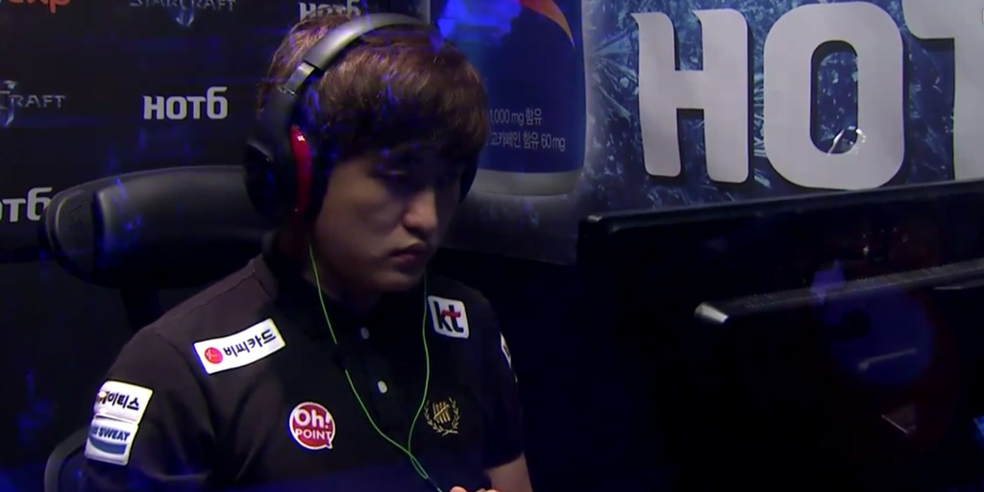
Data Acquisition
Professional Player
Game
Replays

Slide 25
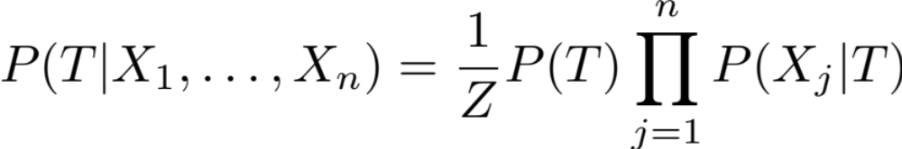
Data Acquisition
Professional Player
Game
Replays
Squad-Action Naïve Bayes
Probability to chose action T given a game state X
(X = set of current possible actions)

Slide 26
Data Acquisition
Professional Player
Game
Replays
Squad-Action Naïve Bayes
Probability to choose action T

Slide 27
Data Acquisition
Professional Player
Game
Replays
Squad-Action Naïve Bayes
Probability of action X_{j} was an option when action T was selected

Slide 28
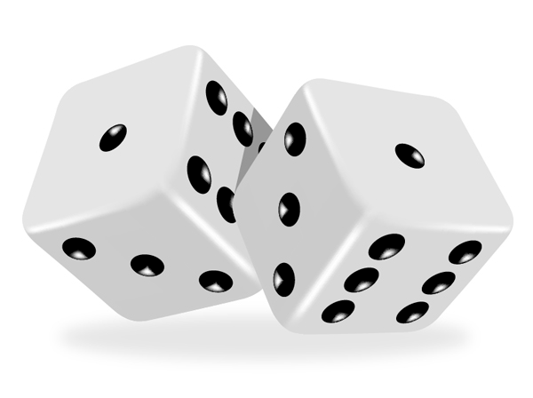
Epsilon-Greedy Sampling
Explore (20%)
Exploit (80%)
Select
Using a Uniform Distribution
Select
Current Best

Slide 29
Informed Epsilon-Greedy Sampling
Explore (20%)
Exploit (80%)
Select
Using our Naïve Bayes Distribution
Select
Current Best
Squad-Action Naïve Bayes

Slide 30
Best Informed E-Greedy Sampling
If none of the children have been explored:
Select Most Probable action
from our Naïve Bayes Distribution
Else:
Explore (20%)
Exploit (80%)
Select
Using our Naïve Bayes Distribution
Select
Current Best

Slide 31
MTCS Policies
We can use the new sampling strategies in both MCTS policies: Tree Policy and Default Policy

Slide 32
MTCS Policies Experiments
Tree Policy | Default Policy
ε | UNIFORM
ε | NB
NB-ε | NB
BestNB-ε | NB

Slide 33
MTCS Policies Experiments
No fog of war
Tree Policy | Default Policy
ε | UNIFORM
ε | NB
NB-ε | NB
BestNB-ε | NB
1 MCTS search every 400 frames (16s)
TvT, default AI

Slide 34
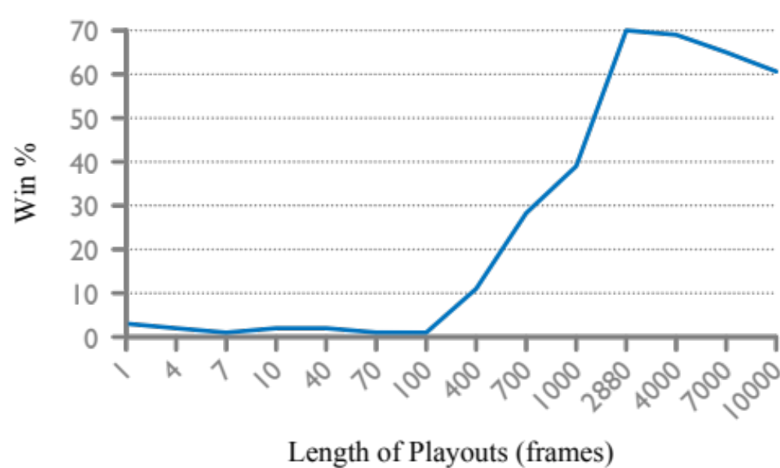
How deep to search?
Simulating until reaching the end of the game is not feasible
2 min in the future

Slide 35
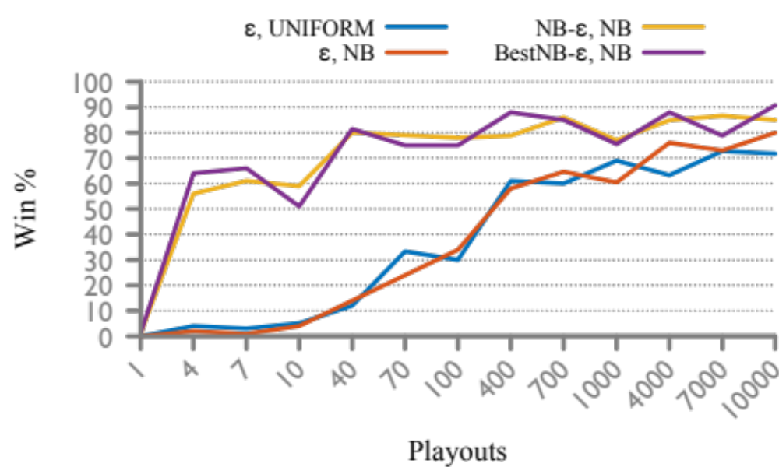
Experiments

Slide 36
Experiments
the remaining 10% are ties

Slide 37
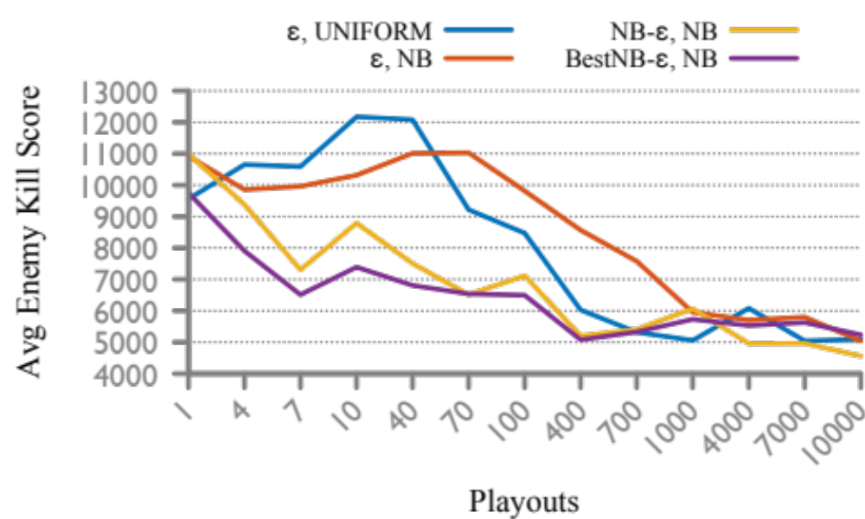
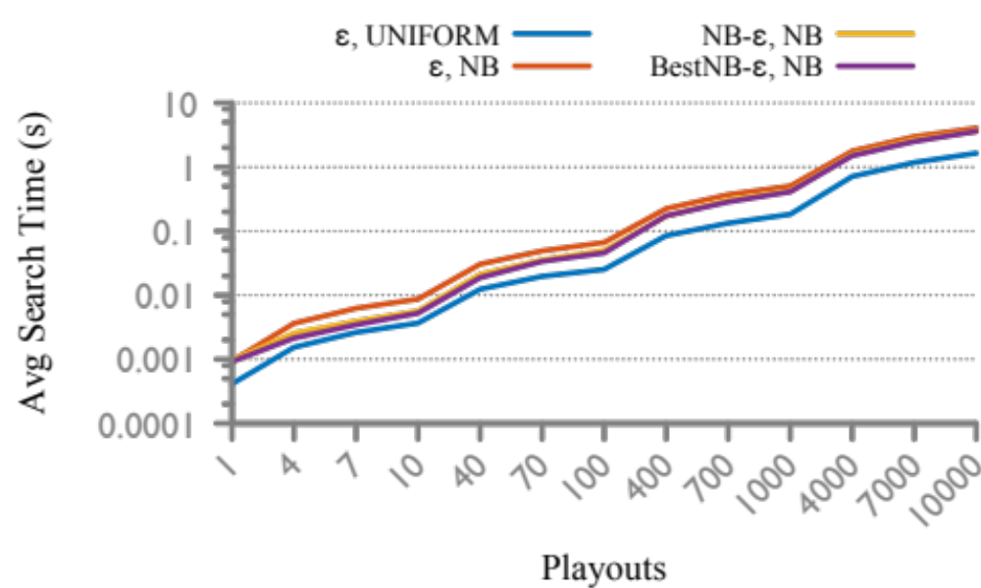
Experiments

Slide 38
Conclusions
BestNB-ε, NB policies with 40 playouts wins 80% with less than 0.1s spend per search
BestNB-ε wins in less time and loses less units than NB-ε

Slide 39

Improving Monte Carlo Tree Search Policies in StarCraft
via Probabilistic Models Learned from Replay Data
Alberto Uriarte albertouri@cs.drexel.edu
Santiago Ontañón santi@cs.drexel.edu
Lab looking for new PhD students!!!!

