Slide 1

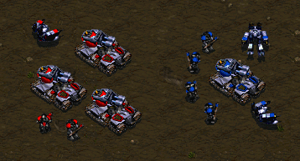

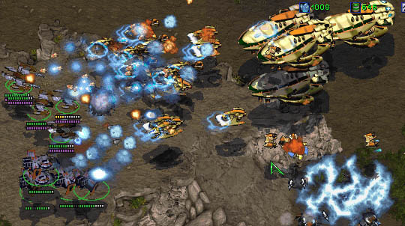


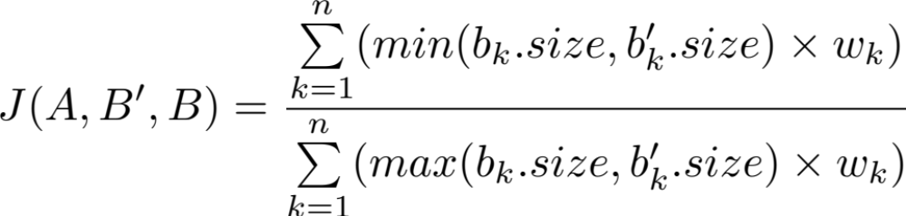
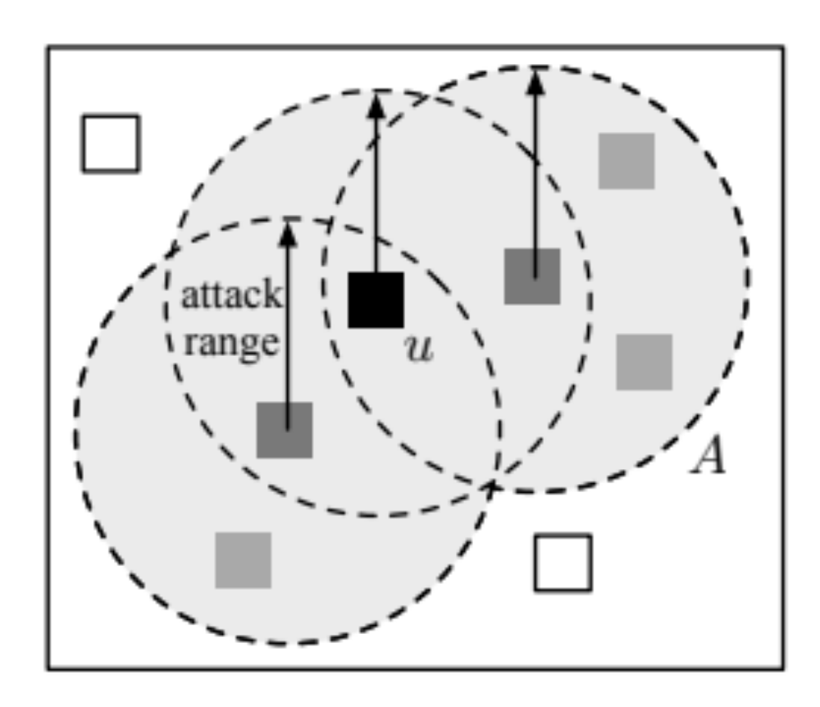
Automatic Learning of Combat Models for RTS Games
Alberto Uriarte
albertouri@cs.drexel.edu
Santiago Ontañón
santi@cs.drexel.edu
Motivation & Goal
Combat Parameters
Abstraction
Game-tree search algorithms require a forward model or “simulator”.
In some games (like StarCraft) we don’t have such model.
The most complex part of a forward model for RTS games is the combat.
In this paper, our goal is to obtain a fast and high-level combat model.
Combat parameters can be learned or hardcoded.
Unit DPF
Hardcoded | Computed using the weapon damage and the time between shots.
Learned | When a unit is killed compute the (unit’s HP / time attacking unit) / number of attackers
Why fast?
To use algorithms like MCTS we need to simulate thousands of combats really quick.
group | Player | Type | Size
g₁ | red | Worker | 1
g₂ | red | Marine | 2
g₃ | red | Tank | 3
g₄ | blue | Worker | 2
g₅ | blue | Marine | 4
g₆ | blue | Tank | 1
Target Policy
Hardcoded | Sort unit by kill score (resources cost metric).
Learned | Used the Borda count method to give points towards a unit type each time we make a choice.
Why high-level?
Even an “attrition game” (an abstraction of a combat game where units cannot move) is EXPTIME. So this is already a hard problem. A high-level model reduces branching factor.
hardcoded
abstraction
Combat
Parameters
High-level
combat
Game
Replays
extract
learn
StarCraft Game
Combat
Records
Results
Professional Player
Combat
Model
prediction
The similarity between the prediction of our forward model (B′), and the actual outcome of the combat in the dataset (B) is defined as:
Combat Parser
Start tracking a new combat if a military unit is aggressive or exposed and not already in a combat.
aggressive when it has the order to attack or is inside a transport.
exposed if it has an aggressive enemy unit in attack range.
The filled squares are the units involved in a combat triggered by u.
Combat Models
Sustained DPF model
Compute how much time each army needs to destroy the other using the Damage Per Frame (DPF) of each group. Remove the army that took longer to destroy enemy. Remove casualties from winner army using a target policy.
Simpler and Faster.
Model accuracy after learning from more than 1,500 combats extracted from replays
 | Hardcoded | Learned
Sustained Model | 0.861 | 0.848
Decreased Model | 0.905 | 0.888
Model accuracy and time compared with a low-level model
Decreased DPF model
Compute how much time to kill one enemy’s unit. Remove the unit killed and reduce HP of survivors. Back to point 1 until one army is destroyed.
Can be stopped at any time to have a prediction after X frames. More accurate predictions.
 | Accuracy | Time (sec)
Sustained Model | 0.874 | 0.033
Decreased Model | 0.885 | 0.039
SparCraft (AC) | 0.891 | 1.681
SparCraft (NOK-AV) | 0.875 | 1.358
SparCraft (KC) | 0.850 | 6.873
43 x faster!!!

